Slide 1
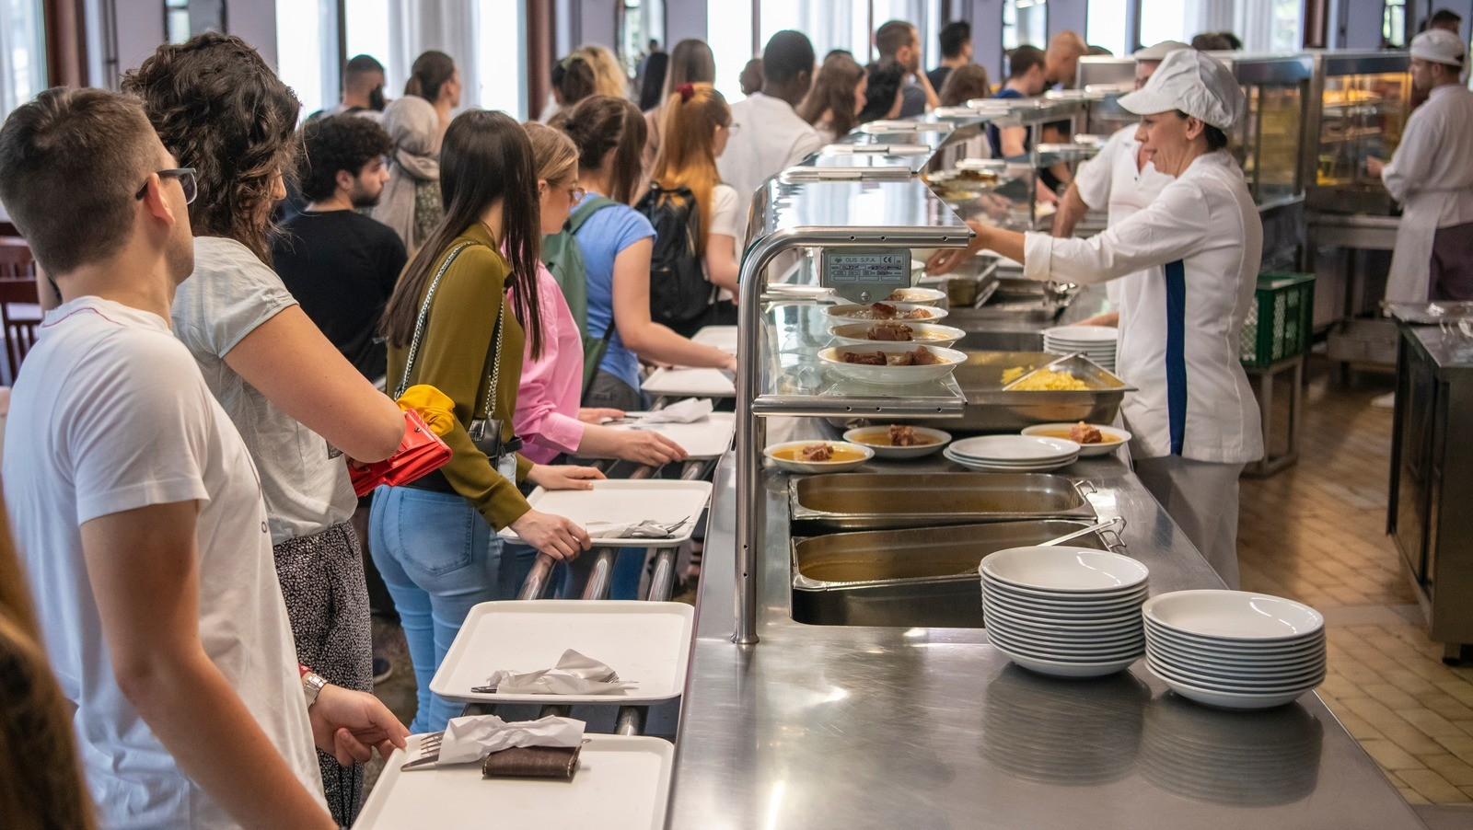

UNILEVER CANTEEN ORDERING SYSTEM
By Business Builders
Pitch

Slide 2

introduction
Unilever is a British-Dutch FMCG company based in London, England. Its products are sold in about 190 countries. The UK offices have 1,500 employees across 12 floors, with only 2 canteens that can seat around 150 people each.
About

Slide 3
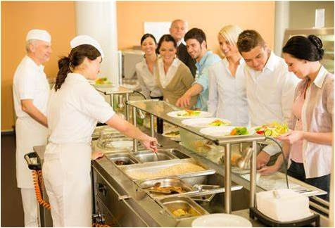
PROBLEM STATEMENT
Unilever's canteen struggles to serve 1,500 employees due to limited seating. At peak times, employees face long waits, overcrowding, and not enough places to sit, leading to a poor dining experience. This reduces employee satisfaction and causes delays in returning to work after lunch. Solving the seating issue is important for improving both the dining experience and time management.

Slide 4
Proposed SOLUTION
Pre-Order system
Take away& Desk delivery options
Develop a meal ordering and reservation system that allows employees to pre-order and reserve meals. This system will enable them to pick up their meals at a preferred time without waiting in line, reducing time spent in the canteen and improving efficiency with designated pick-up counters.
Set up takeaway stations and food delivery carts in the canteen to deliver meals directly to employees' workspaces. This allows employees to order food for delivery or pick up and eat in other areas like meeting rooms or lounges, reducing the number of people in the cafeteria and easing seating pressure during peak hours.
Cafeteria expansion/ redesign
EMPLOYEE COMMUNICATION & AWARENESS
Assess the space to find underused areas that can be turned into extra seating. Use flexible seating like collapsible or stackable chairs to adjust for different needs. Redesign the canteen with efficient seating, like communal tables or bar-style seating, to fit more people during busy times without needing extra space.
Use a display system or app to show real-time seating availability and promote early or late lunch slots. Educate employees on staggered lunch times and provide updates on canteen occupancy through email, apps, or digital displays to help them plan their breaks more efficiently.

Slide 5
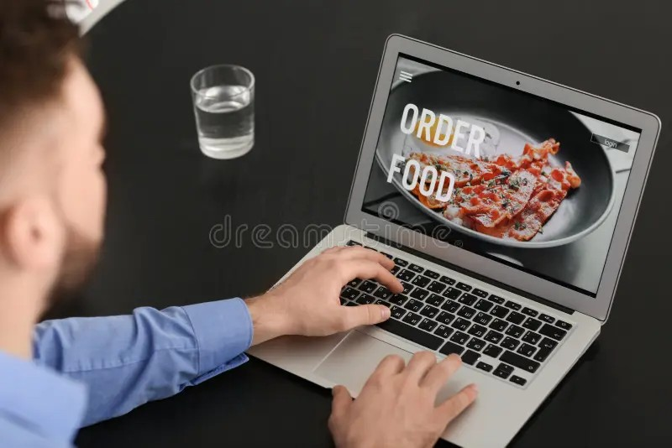
OBJECTIVES
________________________________________
Implement a simple and efficient canteen ordering system to reduce congestion, shorten wait times, and improve the dining experience. The system will offer options like takeaway, pre-ordering, and staggered dining times, helping employees get their meals quickly while maximizing canteen capacity.

Slide 6
RACI MATRIX
Tasks/Activities | Project Sponsor | Scrum Master | Product Owner | Developers | UI/UX | System Administrator | QA/Testers | HR Dept | Finance Dept | Canteen Staff | Employees
Requirement Elicitation and Documentation | C,I | A | R | I | I | I | I | I | I | C,I | C,I
Product Design | C,I | A | C,I | I | R | I | I | I | I | C,I | C,I
Software Implementation | I | A | C,I | R | I | I | I | I | I | I | I
QA/UAT | I | A | C,I | I | I | I | R | I | I | R | R
Change mgt | C,I | A | R | I | I | I | I | I | I | I | I
User training materials | I | A | R | C,I | I | I | I | I | I | I | I
Deployment/go live | I | A | C,I | I | I | R | I | I | I | I | I
Post -Deployment maintenance | I | R,A | C,I | I | I | I | I | I | I | C,I | C,I

Slide 7
SCOPE OF THE PROJECT
OVERVIEW
DELIVERABLES
INCLUSIONS
Online Ordering: Employees can place orders digitally, reducing wait times.
Take-away Options: Flexibility to pick up food without dining on-site
.Flexible Payment Methods: Variety of payment choices for convenience.
Real-time Updates: Live seating availability and meal preparation statuses.
1.Ordering System(Web and Mobile App)
2.Seating Optimization
3. Sustainability Features(Eco-friendly packaging for takeaways).
4. Employee Benefits Integration
5. Admin Dashboard and Analytics
6.User Experience (UX/UI) and Design
7.User Acceptance Testing (UAT)
1.Software Development
2.User friendly interface design 3.Testing and quality assurance 4.Deployment and rollout
5.Training and support

Slide 8
OUT OF SCOPE
What’s Not Included:
Canteen Expansion: No physical growth of the canteen; only optimization of existing space.
Hardware: No new hardware installations (like kiosks or seat sensors) in this phase.
Dietary Consultation: Only nutritional info will be provided, not full dietary consultations.
External Delivery: The system will not handle food delivery outside the canteen.
Post-Warranty Support: Ongoing support after the warranty will be covered by a separate contract.

Slide 9
PROJECT TIMELINE
Project Phases:
1. Research and Requirements (2–4 weeks):Interview stakeholders, analyze needs, and conduct a feasibility study.
2. Design and Prototyping (4–6 weeks):Create and get approval for UI/UX designs and wireframes.
3. Development (10–12 weeks):Build the core features (ordering, payment, seating management).
4. Testing and QA (4–6 weeks): Perform functional, user acceptance, and performance testing.
5. Deployment and Training (2–4 weeks): Launch the pilot, train employees, and deploy the system.
6. Post-launch Support (Ongoing):Provide bug fixes, updates, and develop additional features.

Slide 10
FINANCIAL PROJECTION
COST
Phase | Duration | Cost (£)
Research and Requirements | 2-4 weeks | £15,000
Design and Prototyping | 4-6 weeks | £35,000
Development | 10-12 weeks | £120,000
Testing and QA | 4-6 weeks | £30,000
Deployment and Training | 2-4 weeks | ££25,000
Post-launch Support | Ongoing | £15,000 (first 3 months)
Total Estimated Cost: £240,000

Slide 11
FINANCIAL PROJECTION - CONTINUED
Projected Benefits and Savings (Annual)
Food Waste Reduction: £30,000 - £45,000
Staff Productivity Improvement: £60,000 - £90,000
Employee Turnover Reduction: £15,000 - £30,000
Time Saving for Employees: £120,000 - £180,000 (based on average hourly rate)
Total Projected Annual Benefits: £225,000 - £345,000

Slide 12
FINANCIAL PROJECTION – CON’TD
3 Year Financial Projection
Year | Cost (£) | Benefits (£) | Net (£)
Year 1 | 240,000 | 90,000 | -150,000
Year 2 | 30, 000 | 270,000 | 240,000
Year 3 | 30,000 | 330,000 | 300,000
Cumulative 3-Year Net Benefits: £390,000
Break – even Point: Approximately 20 months

Slide 13
KEY STAKEHOLDERS
Project Sponsor
|
Project Manager
|
--------------------------------------------------------------------
| | | | |
Business Analyst UI/UX Designer IT Department Finance Dept. HR Dept.
|
--------------------------------------------------------------------
| |
Canteen Manager Employee Representative

Slide 14
EXPLANATION TO SLIDE 13
The Project Sponsor is at the top, overseeing the project.
The Project Manager is responsible for managing the overall project and reports to the sponsor.
Under the Project Manager are key roles such as the Business Analyst, UI/UX Designer, IT Department, Finance Department, and HR Department.
The Canteen Manager and Employee Representative are linked to the HR Department because they are directly involved in employee-related functions and operations.

Slide 15
STAKE HOLDERS REGISTER
NAME | ROLE | REQUIREMENTS | INFLUENCE | INTEREST
Efosa Alonge | Project sponsor | Develops an ordering system to improve employee work efficiency and maximize break time effectively. | High | High
Blessing Salifu | Scrum master/ project manager | Ensures project success and delivery according to specification. | High | High
Olubunmi Akinyemi | Business analyst/ product owner | Advise/ recommend solutions that delivers values. Ensures project delivery aligns with the business objectives and stakeholders expectations. | Low | High
Ann Afolabi | UI/UX | Delivers project design for the ordering system | Low | High
Ifeoluwa Adekoya | Developers | Software implementation | Low | High
Benvinda | System administrators | Seamless product deployment | Low | High
Toyin Onifade | Hr department | Payroll and Welfare | Low | High
Eunice Olorunleke | Finance department | Manages the Budget | Low | High
Grace Okoye | QA/Testers | Develops product to meet the required standard | Low | High
All the 20 canteen staff | Canteen staff | Reduces waste, De-congest the canteen. Prepare meals according to hygienic standards | Low | High
All Employees | Employees | Orders meals online and have it delivered to their workspaces. | Low | High

Slide 16
STAKEHOLDER’S ANALYSIS
HIGH
 | PROJECT SPONSOR PROJECT MANAGER
 | BUSINESS ANALYST UI/UX DEVELOPER SYSTEM ADMINISTRATORS HR ADMINISTRATORS QA/TESTERS FINANCE DEPARTMENT CANTEEN STAFF EMPLOYEES
POWER
LOW
INTEREST
HIGH

Slide 17
RISKS AND ASSUMPTIONS
Assumptions:
•Employees have access to and are comfortable using digital devices.
•Reliable internet infrastructure and IT support are in place.
•Canteen staff will be trained and ready to use the system.
•The current payment systems and seating capacity are sufficient with optimization.
•The project has an adequate budget and resources.
•Employees and management will adopt the system.
•Menu and inventory management will support the system’s features.
•The system will comply with data privacy and financial regulations.
•External vendors and dependencies will not cause delays.
Risks:
Peak-time usage overload may cause system performance issues.
Delayed adoption by employees could lead to under-utilization of the system.
Integration with existing payment gateways or benefits systems may face technical challenges.

Slide 18
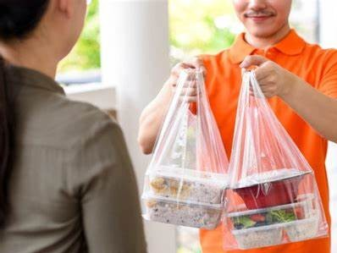
SUCCESS CRITERIA
Reduced wait times: Significant decrease in employee waiting times during peak hours.
Employee satisfaction: Positive feedback from employees regarding the ease of ordering and the overall dining experience.
Increased operational efficiency: Improved kitchen and canteen staff efficiency through pre-orders and real-time tracking.
Cost savings: Reduction in food waste and optimized use of canteen resources.
________________________________________

Slide 19
KEY DEPENDENCIES
Internet and IT Infrastructure: Reliable connectivity and infrastructure.
Payment and Benefits Integration: Connect with payment systems and benefits platforms.
Canteen Staff: Ensure availability and training.
Support and Adoption: Management backing and employee buy-in.
Vendor Quality: Timely and high-quality work from third-party vendors.
Compliance: Adhere to data privacy and payment security regulations.
Resources: Sufficient budget and project team.
Training and Testing: Effective training and feedback from pilot testing.

Slide 20
KEY POINTS OF CONTACTS
Key Contacts for Smooth Communication and Issue Resolution:
- Scrum Master: Coordinates the overall project.
- Development Team Support: Ensures environment readiness and provides technical support.
- IT Support/Infrastructure Team: Handles IT and network support.
- Payment Gateway Provider: Manages payment processing integration.
- Employee Benefits System Administrator: Oversees benefits integration.
- Canteen Manager: Manages operations and staff coordination.
- UX/UI Designer: Focuses on design and user experience.
- Data Analytics/BI Specialist: Manages data analysis and reporting.
- Compliance Officer: Ensures legal and regulatory compliance.
- Helpdesk: Provides support and resolves issues.
- Vendor/Third-Party Contact: Manages external vendor teams.
- Training Coordinator: Handles training and on boarding.

Slide 21
“AS-IS PROCESS”
Employees would prefer to take their lunch between 12 noon to 1 pm.
A huge rush in the canteen during lunch hours resulting in employees wasting a lot of time waiting for tables to be vacant.
It takes around 60 minutes for employees to go and come back from lunch.
Lots of time were wasted in waiting in a queue to collect food and get a table to sit and eat.
Employees don’t always get the choice of food they want because the canteen runs out of certain items.
The canteen wastes a significant quantity of food by throwing away what is not purchased.
Many employees have requested a system that would permit a canteen user to order meals online, to be delivered to their work location at a specified time and date.

Slide 22
EXTERNAL INTERFACES
These interfaces are essential for the smooth operation and seamless integration of the canteen ordering system with existing infrastructure:
Payment Gateway Integration: Facilitates transaction processing.
Employee Benefits Systems: Manages meal subsidies and benefits.
Inventory Management Systems: Monitors stock levels and handles inventory.
Employee Directory Systems: Manages user authentication and accounts.
Communication Platforms: Sends notifications and updates.
Data Analytics Tools: Provides reporting and insights.
Security Systems: Ensures data protection and system security.
Customer Support Systems: Handles support requests and issues.

Slide 23
FEATURE THAT NEEDS TO BE DEVELOPED IN THE NEW SYSTEM
Online ordering
Real- Time Menu Availability
Order tracking and notifications
Secure login system for employees
Order History and reorder
Feedback on overall employees experience
Meal customization based on dietary needs of the employees
Data analytics and reporting tools for management
Payroll integration for payment
Order processing
User Inter-phase

Slide 24
THANK YOU
EUNICE OLORUNLEKE

